Slide 1
Lab 2 System Analysis in Time Domain

Slide 2
Objective
Learn to create functions and scripts.
Zero-input and zero-state response of system.
Find out impulse and step response of system.
Learn the convolution operation with MATLAB.

Slide 3
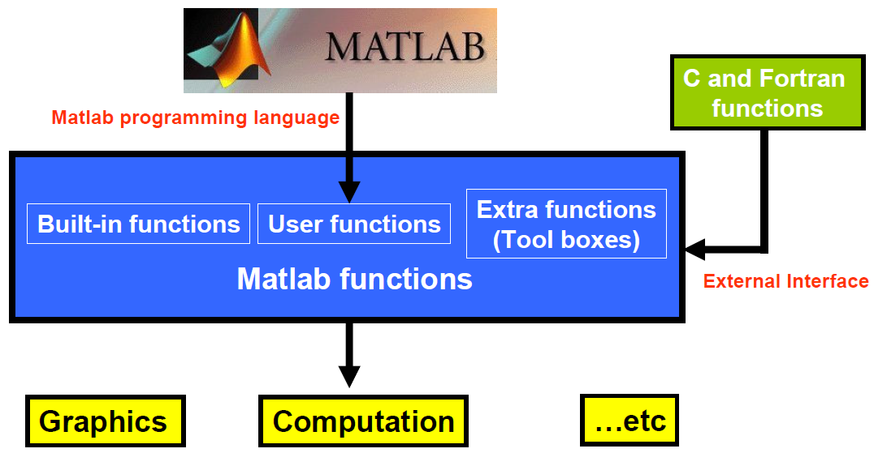
Scripts and Functions

Slide 4
e.g.
Create a Script
Click on the New Script icon on the left side of the Home Tab.
Type a set of executable commands in the editor window.
Save the file in an appropriate folder. The naming rules for script is the same as the rules for variables as mentioned in Lab1.
Set the current directory in MATLAB to the same place where you saved the script file.
To run the script file, hit the green run arrow in the editor window or simply type the name of the file (without the .m extension) at the command prompt in the MATLAB command window.

Slide 5
e.g.
Create a Function
Click the New icon (on the Home Tab) and then Function to create a function.
A function definition line: contains a list of inputs and outputs, which is different from a script.
Comment part: write some description for the function.
Function body: realize what you want the function to do.
To execute the function, type the command in script or in the command window.

Slide 6
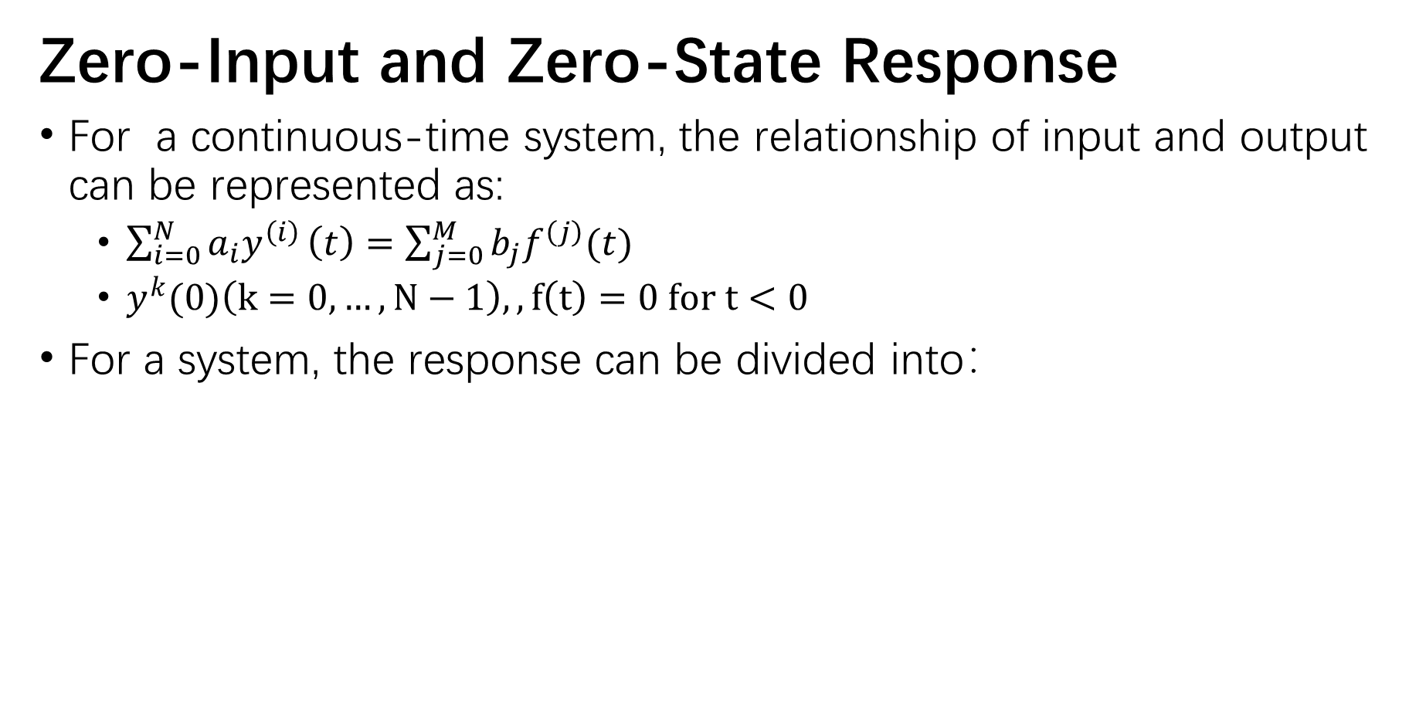
Zero-Input and Zero-State Response
For a continuous-time system, the relationship of input and output can be represented as:
$\sum_{i=0}^{N}{a_{i}y^{\left(i\right)}}\left(t\right)=\sum_{j=0}^{M}{b_{j}f^{\left(j\right)}(t)}$
$y^{k}(0)\left(k=0, …, N−1\right),,f\left(t\right)=0 for t<0$
For a system, the response can be divided into：

Slide 7
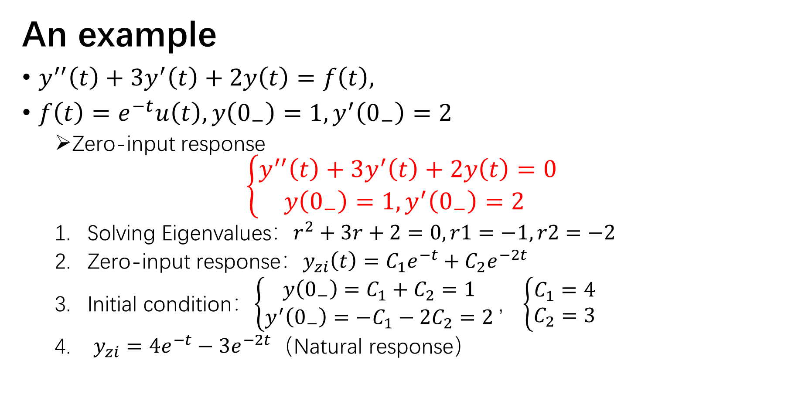
An example
$y^{′′}\left(t\right)+3y^{′}\left(t\right)+2y\left(t\right)=f\left(t\right),$
$f\left(t\right)=e^{−t}u\left(t\right), y\left(0_{−}\right)=1,y^{′}\left(0_{−}\right)=2$
Zero-input response
$$\left\{\begin{aligned}y^{′′}\left(t\right)+3y^{′}\left(t\right)+2y\left(t\right)=0 \\ y\left(0_{−}\right)=1,y^{′}\left(0_{−}\right)=2 \end{aligned}\right.$$
Solving Eigenvalues$：r^{2}+3r+2=0,r1=−1,r2=−2$
Zero-input response：$y_{zi}\left(t\right)=C_{1}e^{−t}+C_{2}e^{−2t}$
Initial condition：$\left\{\begin{matrix}y\left(0_{−}\right)=C_{1}+C_{2}=1 \\ y^{′}\left(0_{−}\right)=−C_{1}−2C_{2}=2\end{matrix}\right.，\left\{\begin{aligned}C_{1}=4 \\ C_{2}=3\end{aligned}\right.$
$y_{zi}=4e^{−t}−3e^{−2t}$（Natural response）

Slide 8
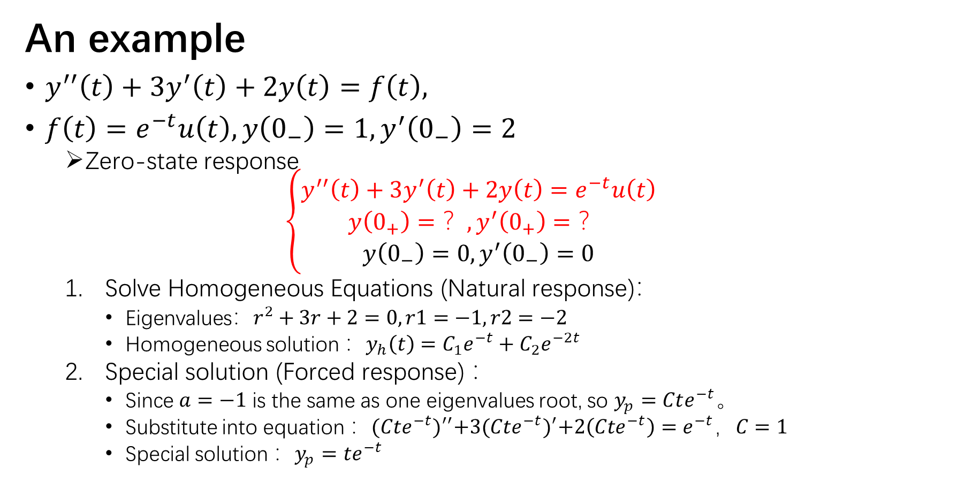
An example
$y^{′′}\left(t\right)+3y^{′}\left(t\right)+2y\left(t\right)=f\left(t\right),$
$f\left(t\right)=e^{−t}u\left(t\right), y\left(0_{−}\right)=1,y^{′}\left(0_{−}\right)=2$
Zero-state response
$$\left\{\begin{aligned}y^{′′}\left(t\right)+3y^{′}\left(t\right)+2y\left(t\right)=e^{−t}u\left(t\right) \\ y\left(0_{+}\right)=？,y^{′}\left(0_{+}\right)=？ \\ y\left(0_{−}\right)=0,y^{′}\left(0_{−}\right)=0\end{aligned}\right.$$
Solve Homogeneous Equations (Natural response)：
$\text{Eigenvalues}：r^{2}+3r+2=0,r1=−1,r2=−2$
Homogeneous solution ：$y_{h}\left(t\right)=C_{1}e^{−t}+C_{2}e^{−2t}$
Special solution (Forced response) ：
Since $a=−1$ is the same as one eigenvalues root, so $y_{p}=Cte^{−t}$。
Substitute into equation ：${(Cte^{−t})}^{′′}+3{(Cte^{−t})}^{′}+2\left(Cte^{−t}\right)=e^{−t}，C=1$
Special solution ：$y_{p}=te^{−t}$

Slide 9
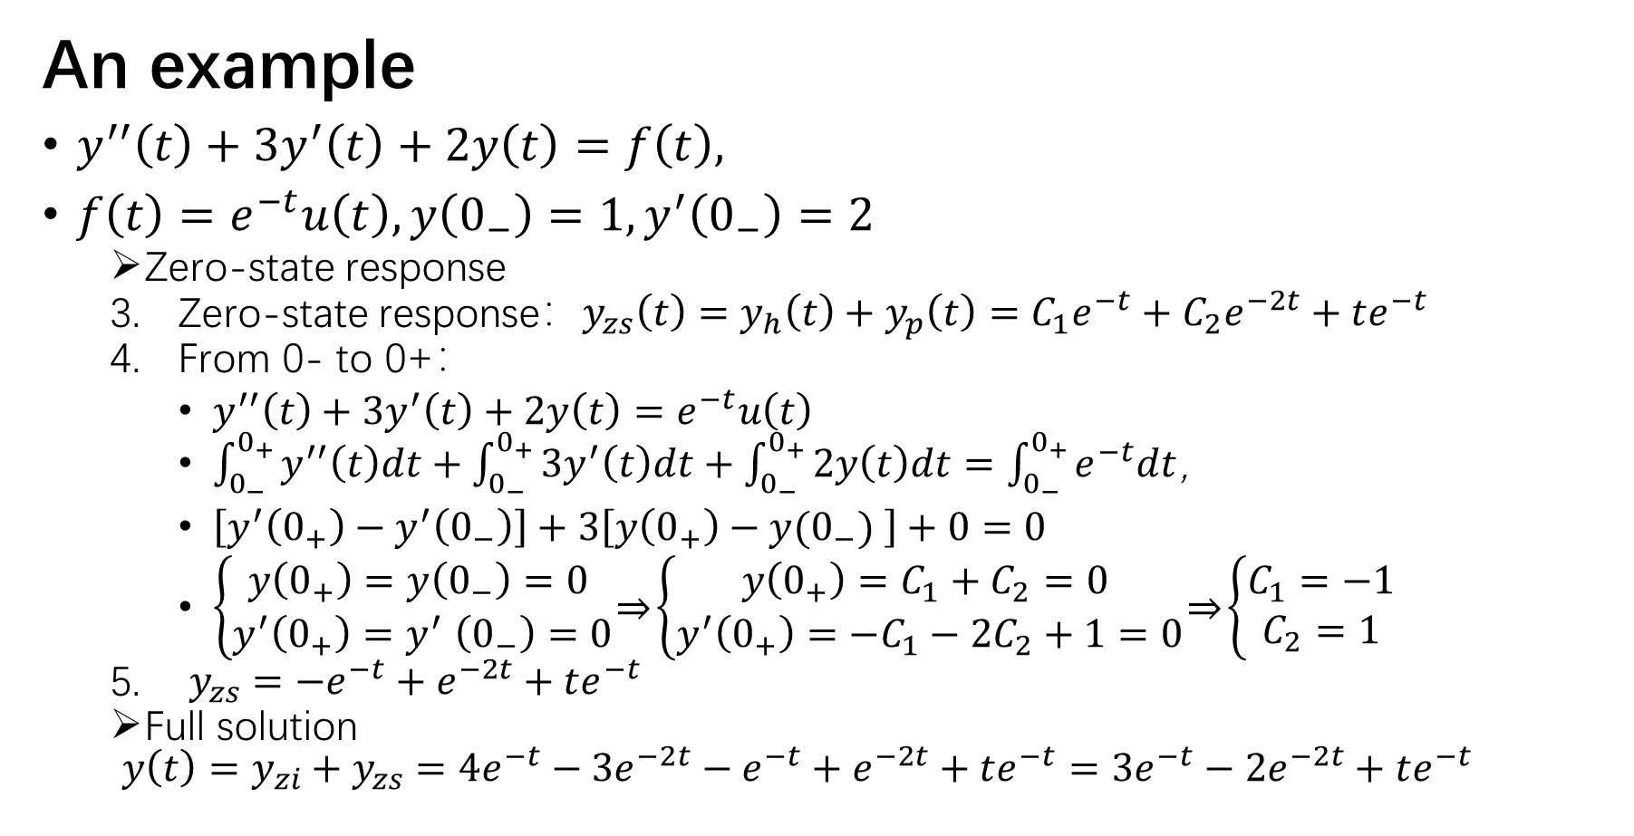
An example
$y^{′′}\left(t\right)+3y^{′}\left(t\right)+2y\left(t\right)=f\left(t\right),$
$f\left(t\right)=e^{−t}u\left(t\right), y\left(0_{−}\right)=1,y^{′}\left(0_{−}\right)=2$
Zero-state response
Zero-state response：$y_{zs}\left(t\right)=y_{h}\left(t\right)+y_{p}\left(t\right)=C_{1}e^{−t}+C_{2}e^{−2t}+te^{−t}$
From 0- to 0+：
$y^{′′}\left(t\right)+3y^{′}\left(t\right)+2y\left(t\right)=e^{−t}u\left(t\right)$
$\int_{0_{−}}^{0_{+}}{y^{′′}\left(t\right)dt}+\int_{0_{−}}^{0_{+}}{3y^{′}\left(t\right)dt}+\int_{0_{−}}^{0_{+}}{2y\left(t\right)dt}=\int_{0_{−}}^{0_{+}}{e^{−t}dt}$，
$\left[y^{′}\left(0_{+}\right)−y^{′}\left(0_{−}\right)\right]+3\left[y\left(0_{+}\right)−y(0_{−}) \right]+0=0$
$\left\{\begin{aligned}y\left(0_{+}\right)=y\left(0_{−}\right)=0 \\ y^{′}\left(0_{+}\right){=y}^{′}\left(0_{−}\right)=0\end{aligned}\right.\underset{⇒}{ }\left\{\begin{aligned}y\left(0_{+}\right)=C_{1}+C_{2}=0 \\ y^{′}\left(0_{+}\right)=−C_{1}−2C_{2}+1=0\end{aligned}\right.\underset{⇒}{ }\left\{\begin{aligned}C_{1}=−1 \\ C_{2}=1\end{aligned}\right.$
$y_{zs}=−e^{−t}+e^{−2t}+te^{−t}$
Full solution
$$y\left(t\right)=y_{zi}+y_{zs}=4e^{−t}−3e^{−2t}−e^{−t}+e^{−2t}+te^{−t}=3e^{−t}−2e^{−2t}+te^{−t}$$

Slide 10
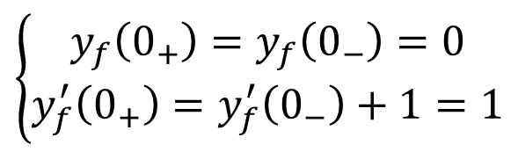
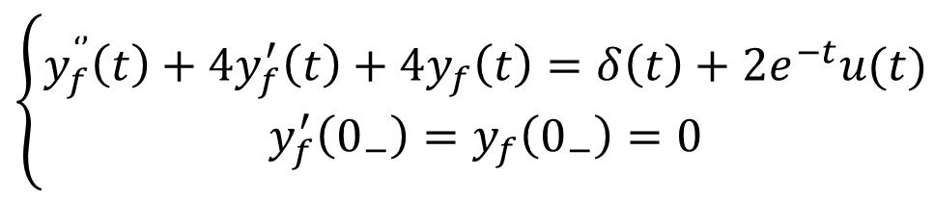

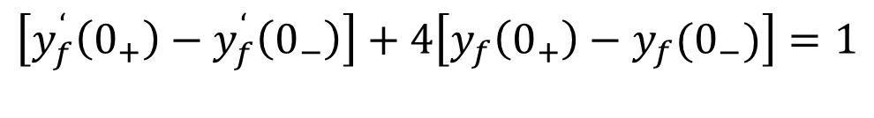

An example
$$\left\{\begin{aligned}y_{f}^{‘’}\left(t\right)+4y_{f}^{′}\left(t\right)+4y_{f}\left(t\right)=δ\left(t\right)+2e^{−t}u(t) \\ y_{f}^{′}\left(0_{−}\right)=y_{f}\left(0_{−}\right)=0\end{aligned}\right.$$
$$y_{f}\left(t\right)=y_{t}+y_{p}=C_{1}e^{−2t}+C_{2}te^{−2t}+2e^{−t},t≥0$$
$$\int_{0_{−}}^{0_{+}}{y_{f}^{‘’}\left(t\right)dt}+4\int_{0_{−}}^{0_{+}}{y_{f}^{‘}\left(t\right)dt}+4\int_{0_{−}}^{0_{+}}{y_{f}\left(t\right)dt}=\int_{0_{−}}^{0_{+}}{δ(t)dt}+2\int_{0_{−}}^{0_{+}}{e^{−t}u(t)dt}$$
$$\left[y_{f}^{‘}\left(0_{+}\right)−y_{f}^{‘}\left(0_{−}\right)\right]+4\left[y_{f}\left(0_{+}\right)−y_{f}(0_{−})\right]=1$$
$$y_{f}\left(0_{+}\right)−y_{f}\left(0_{−}\right)=0$$
$$y_{f}^{’}\left(0_{+}\right)=y_{f}^{’}\left(0_{−}\right)+1=1$$
$$\left\{\begin{aligned}y_{f}\left(0_{+}\right)=y_{f}\left(0_{−}\right)=0 \\ y_{f}^{′}\left(0_{+}\right)=y_{f}^{′}\left(0_{−}\right)+1=1\end{aligned}\right.$$
$$⟹$$

Slide 11
An example
Homogeneous equation
Zero-input response
Initial condition:0-
Full response
Homogeneous equation
(without initial condition)
Non-homogeneous equation
Special solution
Zero-state response
Initial condition:0+

Slide 12

An example
$y^{′′}\left(t\right)+3y^{′}\left(t\right)+2y\left(t\right)=f\left(t\right),$
$f\left(t\right)=e^{−t}u\left(t\right), y\left(0_{−}\right)=1,y^{′}\left(0_{−}\right)=2$
Full solution
$$\left\{\begin{aligned}y\left(t\right)=C_{1}e^{−t}+C_{2}e^{−2t}+te^{−t} \\ y\left(0_{−}\right)=1,y^{′}\left(0_{−}\right)=2 \end{aligned}\underset{⇒}{ }\left\{\begin{aligned}C_{1}=3 \\ C_{2}=−2\end{aligned}\right.\right.$$
Get the full solution$：y_{f}\left(t\right)=3e^{−t}−2e^{−2t}+te^{t}$

Slide 13
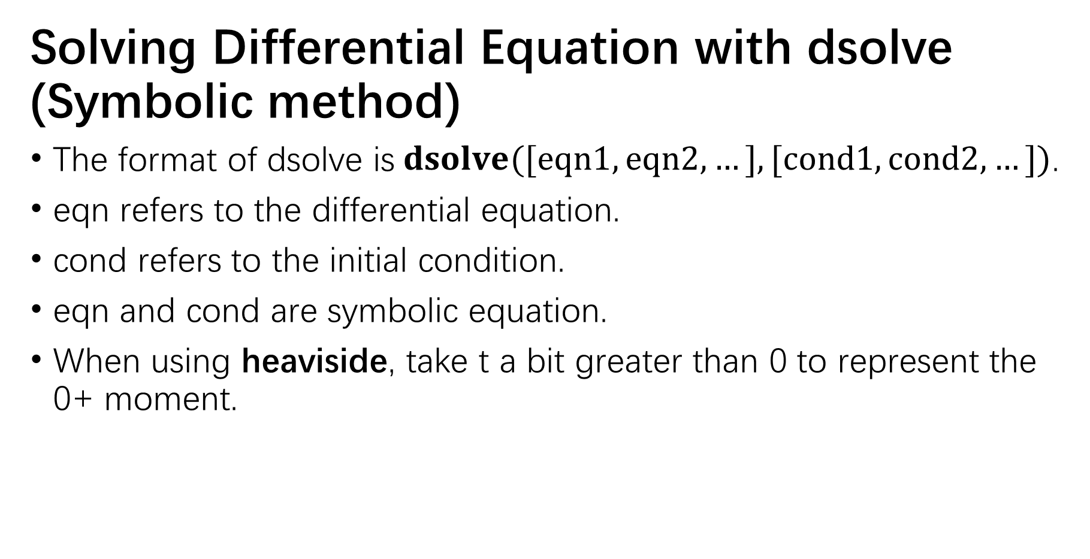
e.g.
Solving Differential Equation with dsolve (Symbolic method)
The format of dsolve is$dsolve([eqn1,eqn2,…],[cond1,cond2,…])$.
eqn refers to the differential equation.
cond refers to the initial condition.
eqn and cond are symbolic equation.
When using heaviside, take t a bit greater than 0 to represent the 0+ moment.

Slide 14
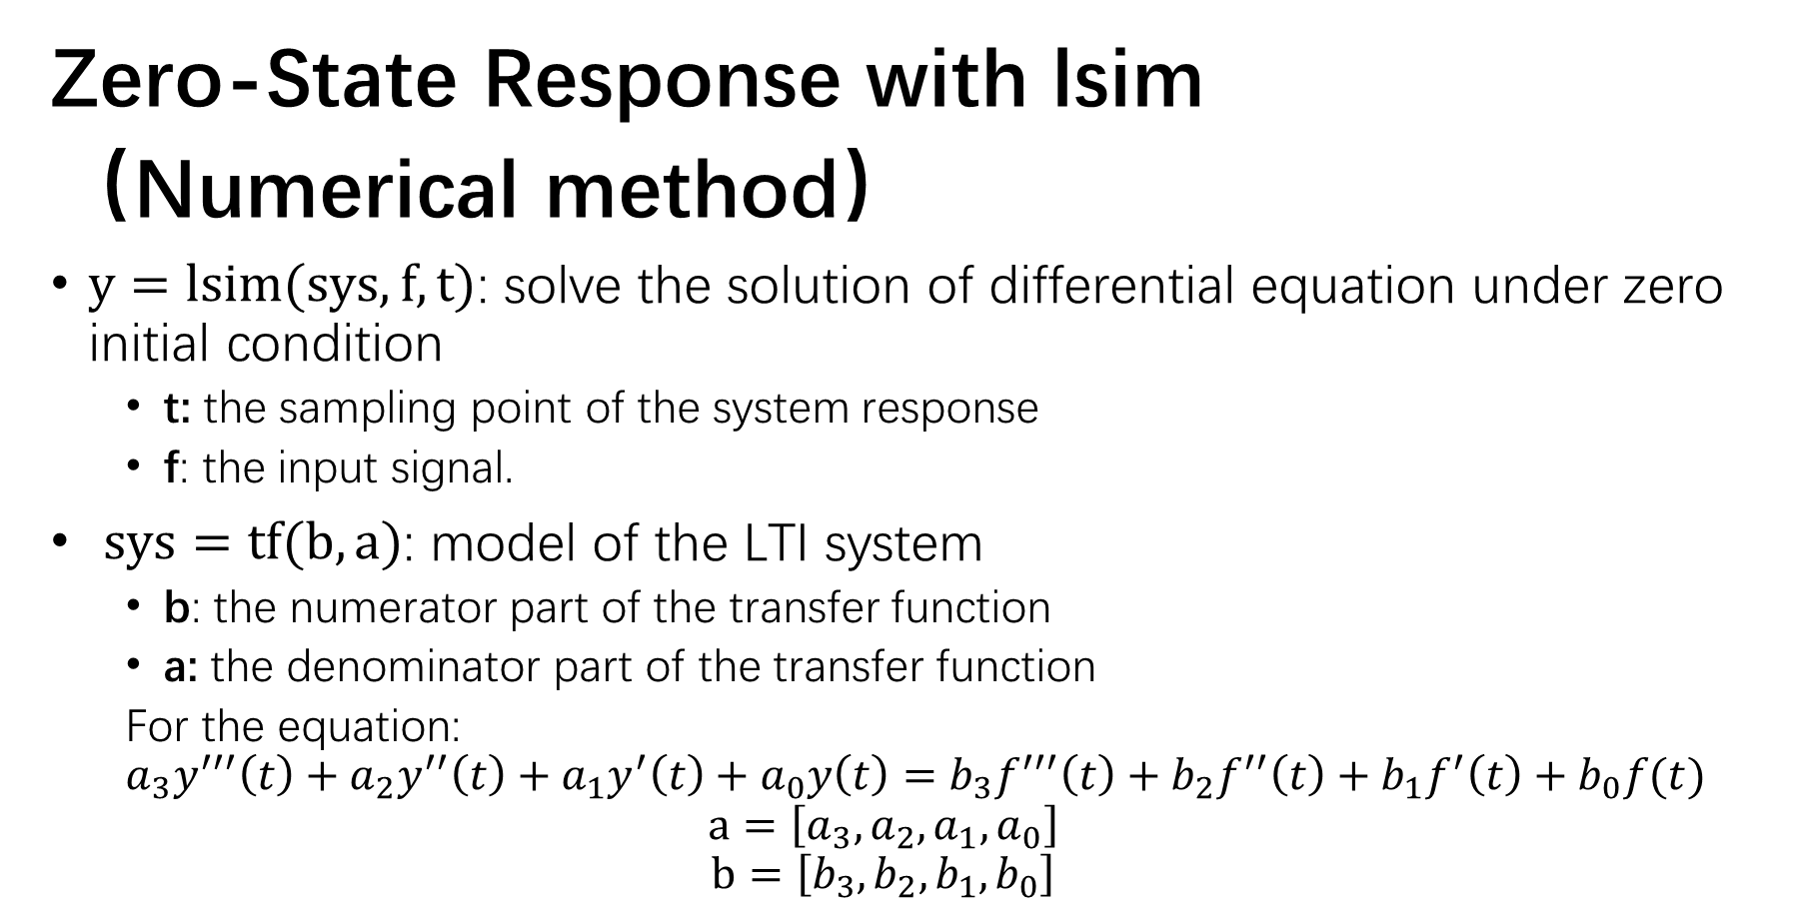
e.g.
Zero-State Response with lsim
（Numerical method）
$y=lsim(sys, f, t)$: solve the solution of differential equation under zero initial condition
t: the sampling point of the system response
f: the input signal.
$sys=tf(b,a)$: model of the LTI system
b: the numerator part of the transfer function
a: the denominator part of the transfer function
For the equation:
$$a_{3}y^{′′′}\left(t\right)+a_{2}y^{′′}\left(t\right)+a_{1}y^{′}\left(t\right)+a_{0}y\left(t\right)=b_{3}f^{′′′}\left(t\right)+b_{2}f^{′′}\left(t\right)+b_{1}f^{′}\left(t\right)+b_{0}f(t)$$
$$a=\left[a_{3},a_{2},a_{1},a_{0}\right]$$
$$b=\left[b_{3},b_{2},b_{1},b_{0}\right]$$

Slide 15
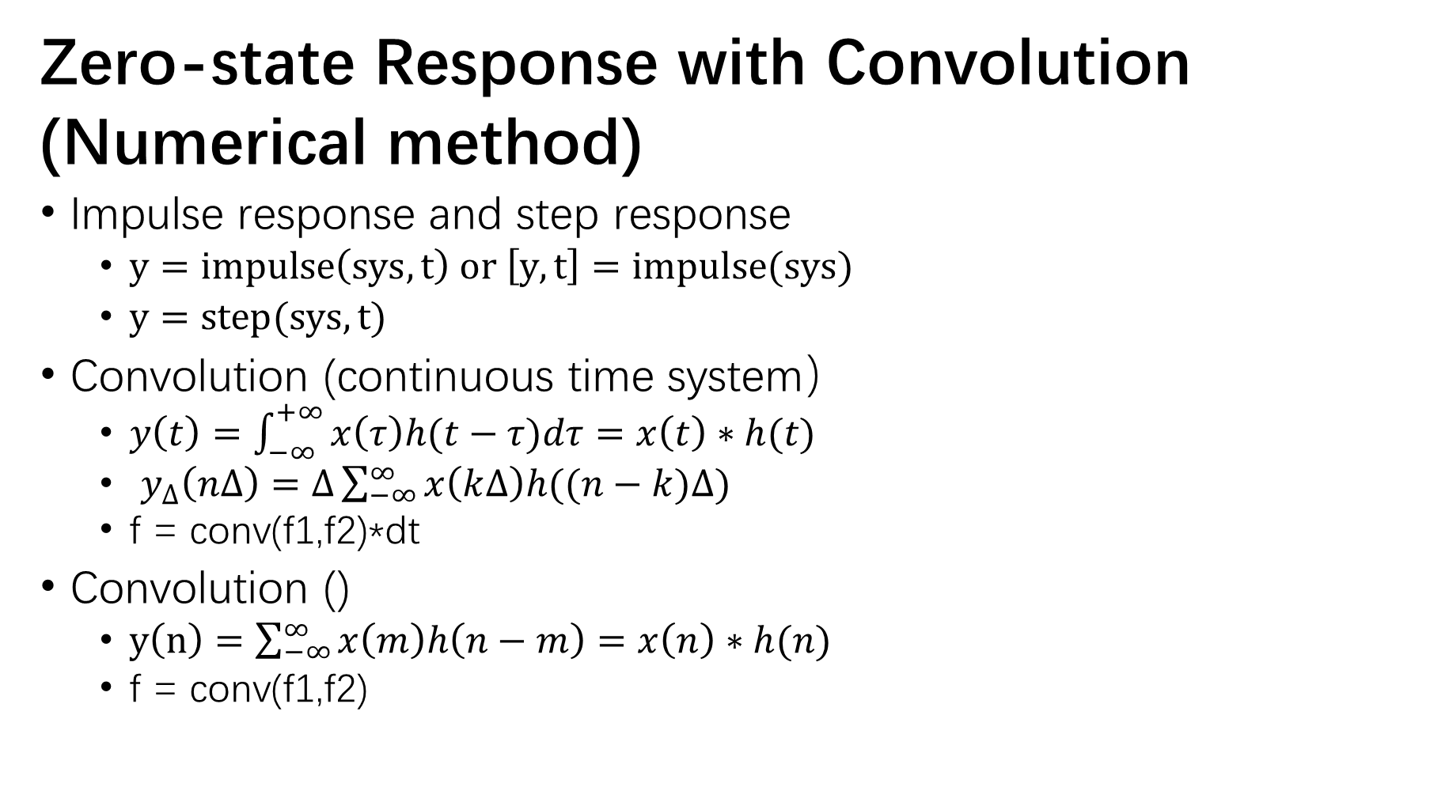
Zero-state Response with Convolution
(Numerical method)
Impulse response and step response
$y=impulse\left(sys,t\right) or \left[y,t\right]=impulse(sys)$
$y=step(sys,t)$
Convolution (continuous time system）
$y\left(t\right)=\int_{−∞}^{+∞}{x\left(τ\right)h(t−τ)dτ}=x\left(t\right)∗h(t)$
$y_{∆}\left(n∆\right)=∆\sum_{−∞}^{∞}{x\left(k∆\right)h((n−k)∆)}$
f = conv(f1,f2)*dt
Convolution ()
$y\left(n\right)=\sum_{−∞}^{∞}{x\left(m\right)h\left(n−m\right)=x\left(n\right)∗h(n)}$
f = conv(f1,f2)

Slide 16
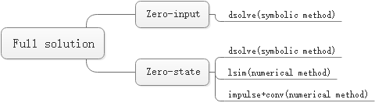
Methods Summary

